Slide 1
Course Outlines – Day 2
Functions
Input from User
Control Statements
Special Control Statements
Arrays
Searching and Sorting
Notes:
Time: 5

Slide 2
Functions
References in Java
Java is strictly “pass-by-value”
Signatures
Naming
Parameters
Returning Values
Static/Non-static Functions
Calling Functions
Notes:
Time: 30
- A "reference" is an alias to another variable. Any manipulation done to the reference variable directly changes the original variable.
- Everyone can easily agree that primitives are passed by value; there's no such thing in Java as a pointer/reference to a primitive.
However, Objects are not passed by reference. A correct statement would be Object references are passed by value. [Javadude.com]

Slide 3
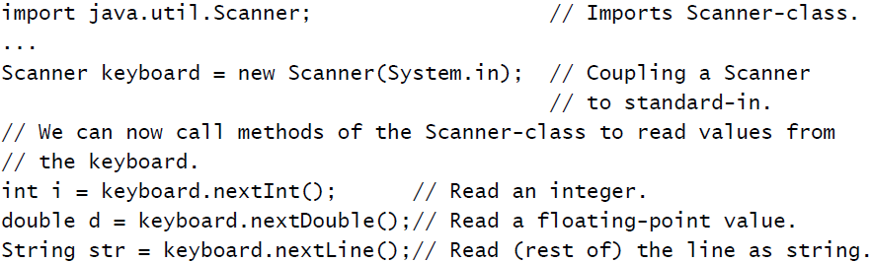
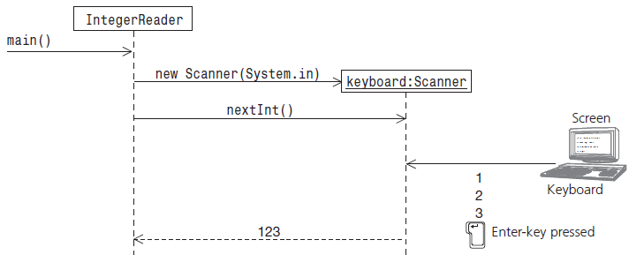
User Input
Scanner Class
Notes:
Time: 20
Slide 26 from “2 Basic Programming Elements.pdf”
in is a static final variable in System class which is of the type InputStream (a built-in class, contains methods to input different data values)

Slide 4
Control Statements
Conditions
If-else
Switch case
Conditional Operators
Loops
For
While
Do-While
Notes:
Time: 5

Slide 5
“If” Condition
If
If-else
If-else if-else
Syntax
Semantics
Nested Conditions
Most common mistakes
Terminator ‘;’
‘=‘ instead of “==“
“==“ instead of equals()
Notes:
Time: 15
Slide 9 from “3 Program Control Flow.pdf”
Syntax: if (<boolean expression>) { /* statements for if body */}
Semantics: Evaluate the boolean expression: If it is true, execute the statements in the if body, and continue with the program. If it is false, skip the if body, and continue with the rest of the program.
Write a function that tells whether a number in parameter is Odd or Even

Slide 6
“Switch” Condition
Just a smarter If
Only Integral types (except long)
char, byte, short, int, Character, Byte, Short, Integer & enum
Defining Conditions as Case(s)
Uses Special Control Statement “break”
Default case
Most common mistake
Not breaking every case
Notes:
Time: 15
Slide 18 from “4 More Program Control Flow Structures.pdf”
- Write a function that inputs month number and prints the month name

Slide 7
Conditional Operators
Handy, inline If
if (number % 2 == 0) {
System.out.print(“Even number”);
} else {
System.out.print(“Odd number”);
}
Can be written as:
System.out.print((number % 2 == 0 ? “Even number” : “Odd number”));
Notes:
Time: 10

Slide 8
For Loop
Used when number of Iterations is Known
Initialization
Loop Condition
Updating
Loop Body
Most common mistakes
Terminator ‘;’
Wrong condition
Wrong updating
Notes:
Time: 20

Slide 9
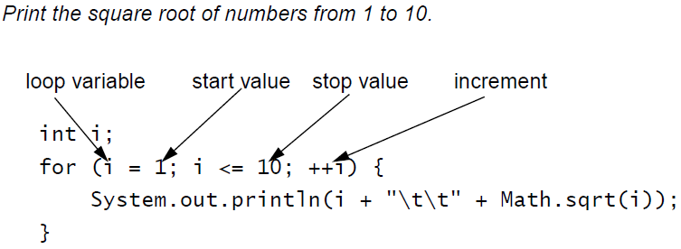
For Loop
Scope of Loop Variable
Initializing multiple Variables
Nested Loops
Backwards Loop
Notes:
Time: 30
- Write a function that inputs phone number in digits and converts to words like “zero three four five …”

Slide 10
While/Do-while Loop
Used when number of Iterations is Unknown
Variable Initialization
Loop Body
Loop Condition
Updating
Do-while Loop
Most common mistakes
Infinite Loop
Input Inside Condition
Notes:
Time: 10
- More on Slide 33 from “3 Program Control Flow.pdf”

Slide 11
Special Control Statements
Branching Statements
Continue
Break
Breaking outer statements with Labels
No GOTO in Java (but the keyword exists)
Return
Try-catch
Notes:
Estimated Time: 3h
What Dijkstra says about Goto: http://goo.gl/mXM2YN
Goto causes Spaghetti code and deadlocks

